Slide 1
Cybersecurity
Keyloggers

Slide 2
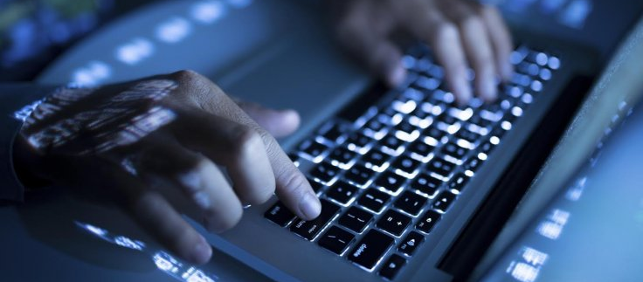
Keyloggers
Keystrokes contain valuable information
Passwords, login URLs, email messages, account information
Save all keyboard input
Sent to hacker
Circumvents encryption protections
Keystrokes are not encrypted
Can log other data to:
clipboard
screenshots
instant messages
search history

Slide 3
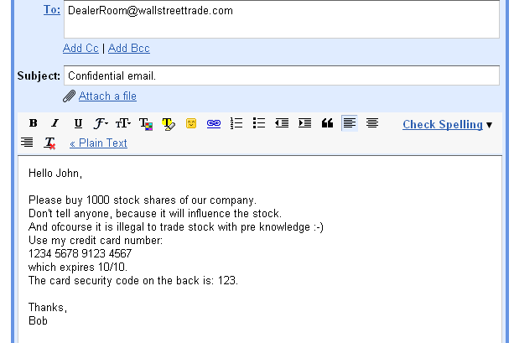
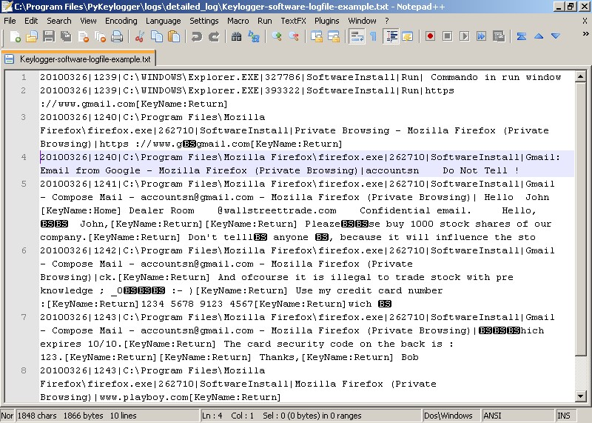
Screenshot of Keylogger output

Slide 4
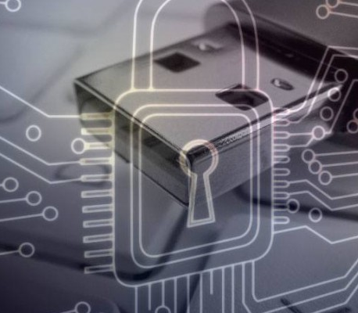
Preventing Keyloggers
Usually installed with malware
Use anti-virus/anti-malware
Keep your signatures updated
Block unauthorized communication
Block the exfiltration attempt
Firewall rules/monitoring
Run a keylogging scanner
Checks for keylogging activity

